Slide 1
CIS 4517/5517: Data Intensive and Cloud Computing Introduction
Dr. Xubin He
Computer and Information Sciences
Temple University

Slide 2
Outline
Syllabus overview
Brief review of parallel and distributed computing
Cloud computing at a glance

Slide 3
06/01/2005
NSF REU Grant
$300K, PI
09/01/2007
NSF CSR Grant
$246K, PI
09/15/2009
NSF CCF Grant
$782K, Site PI
02/01/2014
NSF CCF Grant
$318K, PI
09/01/2015
NSF CCF Grant
$300K, Co-PI
07/01/2018
NSF CCF Grant, $500K, PI
08/01/2023
NSF OAC Grant, $500K, PI
10/01/2003
1st NSF Grant
$200K, Co-PI
06/01/2006
NSF CNS Grant
$100K, PI
09/01/2009
NSF CCF Grant
$300K, PI
09/01/2012
NSF CSR Grant
$432K, PI
09/01/2017
NSF CCF Grant, $450K, PI
01/01/2022
NSF CCF Grant, $500K, PI
10/01/2018
NSF MRI Grant, $400K, Co-PI
Dec. 2006
Aug. 2010
Dec. 2012
Aug. 2013
May 2015
2016
May 2017
1st Ph.D.
2nd Ph.D.
3rd Ph.D.
4th Ph.D.
5th Ph.D.
6,7th Ph.D.
8th Ph.D.
June 2021
Aug. 2002
Sept. 2003
July 2007
Aug. 2010
May 2013
July 2014
Aug. 2016
May 2018
^{10th} Ph.D.
Tenure Track
Assist. Professor
@TTU
Faculty Adjunct
Research Staff
@ORNL
Tenured
Associate
Professor
Joined
VCU
Graduate
Program
Director
Full
Professor
Joined
Temple
^{9th} Ph.D.
Nov 2022
Nov. 2024
^{11th} Ph.D.
^{12th} Ph.D.
2006, 2007, 2009
Sub-awards from ORNL
2012
NVIDIA CUDA
Teaching Center Award
2015
NetApp Research Award
2004
ORAU Ralph E. Powe
Junior Faculty Award
2010
Outstanding Teaching Faculty Award
2015
Outstanding Research Faculty Award

Slide 4
Contact info
Email: Xubin.He@Temple.edu
Office: SERC 352
Office Hours:
Wednesdays 1-3pm
Other times are available by appointment via emails
You are welcome to send me emails with any questions, comments, or suggestions, with the subject line: CIS4517 or CIS5517
TA:
Bowen Xu, Email: bowen.xu@temple.edu
Office: SERC 307
Office hours: Monday 3-4 pm, Thursday 4-5 pm or by appointment

Slide 5
Topics (subjective to change)
Course overview and introduction to cloud computing
Cloud platform practices and Examples
NoSQL and Key-value Databases
Distributed file systems: Hadoop and Google’s GFS
Map/Reduce Programming Model
Virtualization: KVM and Xen
Data mining
Big data principles and practices
Cloud storage and security

Slide 6
Note for CIS5517 students
For students registered for CIS5517, you will expect some additional questions in homework assignments, quizzes, and the final exam.
Each student registered for CIS5517 will have an extra assignment to read a paper related to data-intensive and cloud computing and write a technical report.

Slide 7
Important dates
First day of lecture: 8/28/2024
Midterm progress ratings: 9/30/2024
Thanksgiving holiday: 11/27/2024, no class
Last day of lecture: 12/4/2024
Last day to withdraw: 12/9/2024
Final grading: 12/20/2024
Final exam: 5:45-7:45 pm, December 11, 2024

Slide 8
Usage of AI tools
Temple has established a blanket policy that the use of generative AI tools is prohibited for students, unless an instructor explicitly grants permission.
No AI tools should be used for your homework assignments and projects.

Slide 9
Syllabus Overview

Slide 10
Brief Review of Parallel and Distributed Computing

Slide 11
Computing Paradigm Distinctions
Centralized Computing
All computer resources are centralized in one physical system.
Parallel Computing
All processors are either tightly coupled with central shared memory or loosely coupled with distributed memory
Distributed Computing
A distributed system consists of multiple autonomous computers, each with its own private memory, communicating over a network.
Cloud Computing
An Internet cloud of resources that may be either centralized or decentralized. The cloud applies to parallel or distributed computing or both. Clouds may be built from physical or virtualized resources.

Slide 12
Flynn’s Taxonomy
M.J. Flynn, "Very High-Speed Computers", Proc. of the IEEE, V 54, 1900-1909, Dec. 1966.
Flynn classified by data and control streams in 1966
SIMD ⇒ Data Level Parallelism
MIMD ⇒ Thread Level Parallelism
Single Instruction Single Data (SISD) (Uniprocessor) | Single Instruction Multiple Data SIMD (single PC: Vector, CM-2)
Multiple Instruction Single Data (MISD) (????) | Multiple Instruction Multiple Data MIMD (Clusters, SMP servers)

Slide 13
Back to Basics
“A parallel computer is a collection of processing elements that cooperate and communicate to solve large problems fast.”
Parallel Architecture = Computer Architecture + Communication Architecture
2 classes of multiprocessors :
Centralized Memory Multiprocessor
< few dozen processor chips (and < 100 cores)
Small enough to share single, centralized memory
Physically Distributed-Memory multiprocessor
Larger number chips and cores.
BW demands ⇒ Memory distributed among processors

Slide 14
Centralized vs. Distributed Memory
Scale
P
P
P
1
n
P
n
1
$
$
$
$
Mem
Mem
Inter
connection network
Inter
connection network
Mem
Mem
Centralized Memory
Distributed Memory

Slide 15
Challenges of Parallel Processing
First challenge is % of program inherently sequential
Suppose 80X speedup from 100 processors. What fraction of original program can be sequential?
10%
5%
1%
<1%

Slide 16
Amdahl's Law
Defines the Speedup that can be gained by using a special feature
Speedup due to enhancement E:
ExTime w/o E Performance w/ E
Speedup(E) = ------------- = -------------------
ExTime w/ E Performance w/o E
F E
Find how Speedup coming from some enhancement E
Suppose that enhancement E accelerates a fraction F of the task by a factor S, and the remainder of the task is unaffected

Slide 17
Amdahl’s Law
ExTime_{new} = ExTime_{old} x (1 - Fraction_{enhanced}) + Fraction_{enhanced}
Speedup_{enhanced}
1
ExTime_{old}
ExTime_{new}
Speedup_{overall} =
=
(1 - Fraction_{enhanced}) + Fraction_{enhanced}
Speedup_{enhanced}

Slide 18
Now let’s look at the problem…
Suppose 80X speedup from 100 processors. What fraction of original program can be sequential?
10%
5%
1%
<1%

Slide 19
Amdahl’s Law Answers

Slide 20
Another example
If Floating point instructions are improved to run 2 times faster, while only 10% of actual instructions are FP, what is the overall speedup after this enhancement?
ExTime_{new} =
Speedup_{overall}
=

Slide 21
Amdahl’s Law
If Floating point instructions are improved to run 2 times faster, while only 10% of actual instructions are FP, what is the overall speedup after this enhancement?
ExTime_{new} = ExTime_{old} x (0.9 + .1/2) = 0.95 x ExTime_{old}
1
Speedup_{overall}
=
=
1.053
0.95

Slide 22
One more example:
A program spent 90% time on doing computing jobs, and other 10% time on disk accesses. If we use a 100 times faster CPU, how much speedup we gain?

Slide 23
Amdahl’s Law
A program spent 90% time on doing computing jobs, and other 10% time on disk accesses. If we use a 100 times faster CPU, how much speedup we gain?
ExTimenew = ExTimeold x (0.9/100 + 0.1) = 0.109 x ExTimeold
1
Speedup_{overall}
=
=
9.17
0.109

Slide 24
Amdahl’s Law
t
s
ft
s
(1
-
f
)
t
s
Serial section
Parallelizable sections
(a) One processor
(b) Multiple
processors
p
processors
t
(1
-
f
)
t
s
/
p
p
Even with infinite number of processors, maximum speedup limited to 1/f.
Example: With only 5% of computation being serial, maximum speedup is 20, irrespective of number of processors.

Slide 25
The Implication of Amdahl’s Law
20
f
= 0%
Speedup S(p)
16
12
f
= 5%
8
f
= 10%
4
f
= 20%
4
8
12
16
20
Number of processors
,
p

Slide 26
Challenges of Parallel Processing
Second challenge is long latency to remote memory
Suppose 32 CPU MP, 2GHz, 200 ns remote memory, all local accesses hit memory hierarchy and base CPI is 0.5. (Remote access = 200/0.5 = 400 clock cycles.)
What is performance impact if 0.2% instructions involve remote access?
1.5X
2.0X
2.5X

Slide 27
CPI Equation
CPI = Base CPI + Remote request rate x Remote request cost
CPI = 0.5 + 0.2% x 400 = 0.5 + 0.8 = 1.3
No communication is 1.3/0.5 or 2.6 faster than 0.2% instructions involving remote access

Slide 28
Parallelism
Find enough parallelism (Amdahl’s Law)
Parallelism overheads include:
Cost of starting a thread or process
Cost of communicating shared data
Cost of synchronizing
Extra (redundant) computation
Tradeoff: Program needs sufficiently large units of work to run fast in parallel (i.e., large granularity), but not so large that there is not enough parallel work

Slide 29
Load balancing
Load imbalance leads to some idle resources (e.g. processors) in the system
Insufficient parallelism (during that phase)
Unequal size tasks
Program needs to balance load
Sometimes can determine workload, divide up evenly, before starting: static load balancing
Sometimes workload changes dynamically, need to rebalance dynamically: dynamic load balancing

Slide 30
Languages, frameworks, and system support for parallel/distributed computing
C/S vs P2P:
Client-server model: sockets, RPC (remote procedure call) & RMI (remote method invocation), web services (XML, SOAP, HTTP)
MPI (message passing interface) vs. SVM (shared virtual memory)
Parallel programming languages/programming model: ADA, Split-C, Linda, High Performance Fortran, Map/Reduce, .NET
Distributed files systems (Sun’s NFS, CMU’s AFS & Coda, Google’s GFS, HDFS)

Slide 31
Cloud computing: what and why?

Slide 32
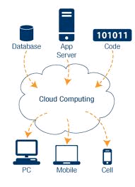
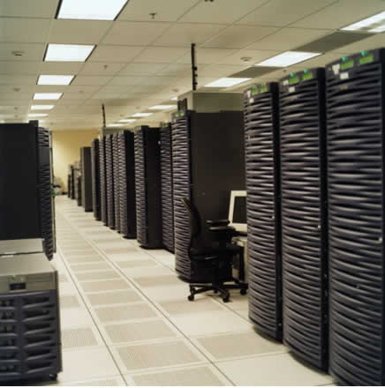
Cloud computing at a glance
Utility computing: our data and applications are hosted somewhere on the Internet (“in the cloud”)
Most services we access over the Internet are in the cloud (e.g., Google, Amazon, Yahoo)
Benefits:
Providers: economies of scale by having many users sharing the same infrastructure
Consumers: reduced cost and overhead
Cloud infrastructure =
Data centers with
100,000’s servers

Slide 33
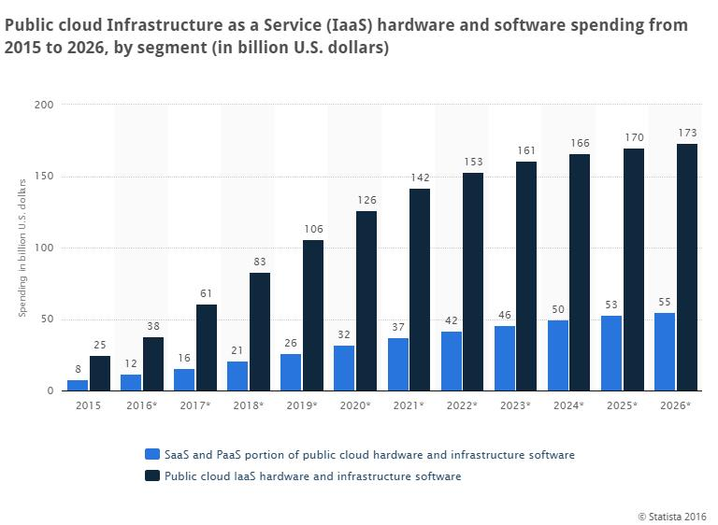
Cloud computing is a big industry

Slide 34
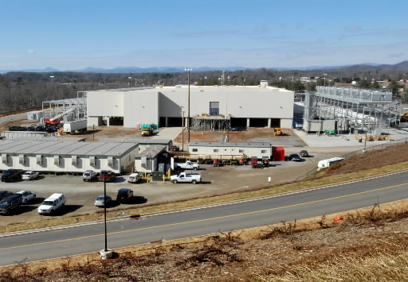
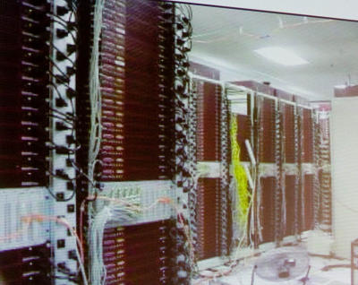
How it all started
Very large data centers with low utilization on average
How about renting computers when load is low?
Google data center video: https://www.youtube.com/watch?v=XZmGGAbHqa0

Slide 35
What is cloud computing?
Cloud computing means storing and accessing data and programs over the Internet instead of your computer's hard drive. --PC Mag
Cloud computing is the delivery of computing services—servers, storage, databases, networking, software, analytics, and more—over the Internet (“the cloud”). --Microsoft
Cloud computing is the on-demand delivery of compute power, database storage, applications, and other IT resources through a cloud services platform via the internet with pay-as-you-go pricing. –Amazon
A video on Youtube
A history of cloud computing, Computer Weekly

Slide 36
Cloud platforms
Amazon Web Services (AWS).
Google AppEngine.
Microsoft Azure
Any many others….

Slide 37
Amazon AWS
https://aws.amazon.com/
AWS free tier: three options: always free/12 month free/trials
Create your own AWS account if you don’t have one and play with it.
AWS starter account is free, but some function might be restricted.
Remember to stop your instance (your machine on the cloud) when you don’t use it. Otherwise, your machine will keep running and your free credit will run out quickly!

Slide 38
Next
HW1 is posted in Canvas.
Step-by-step guide on launching AWS and more resources are provided in course canvas under “Resources” section. Please check them offline by yourself.
Next class: Cloud platforms

